Slide 1
Supermarket Sweep
CLASSIFYING FUTURE INSTACART PURCHASE BEHAVIOR
Leang Chaing

Slide 2
End Goal
Leverage purchase behavior data of the first 5 orders to predict future cart size and reorder rates.

Slide 3
Personas
High Reorder Rates/ Large Carts
“Whales”
High Reorder Rates/ Medium Carts
“Guppies”
High Reorder Rates/ Small Carts
“Ad Hoc Purchasers”
Low Reorder Rates/ Large Carts
“Explorers”
Low Reorder Rates/ Medium Carts
“Average Consumer”
Low Reorder Rates/ Small Carts “Snap Decision Makers”
>= 1/2 of items previously ordered
< 1/2 of items previously ordered
>11.5 items per cart
<6.5 items per cart
Notes:
High reorder = more patterned behaviors
Low reorder = more exploratory
Instacart revenue model – some have markups + delivery fees

Slide 4
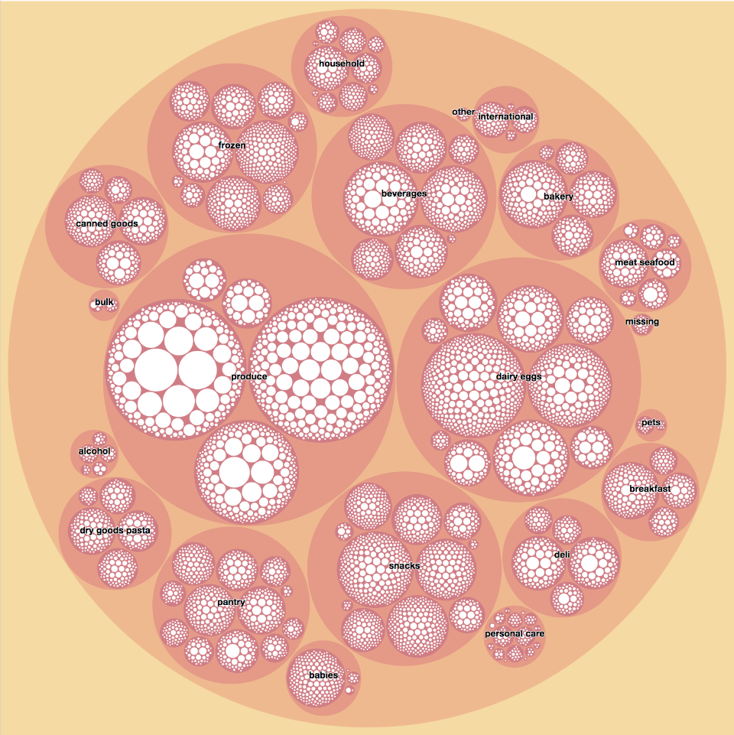
Glut of Data
Departments: 28
Aisles: 134
Products: 49,688
Users: 200K+
Orders: 3MM+
Source: Instacart (Kaggle)

Slide 5
Testing Logs + Trees
Logistic Regression:
Accuracy: 52.1%
Precision: 51%
Recall: 52%
F1: 51%
Random Forest Classifier
Accuracy: 52.1%
Precision: 51%
Recall: 52%
F1: 51%
Naïve Bayes:
Accuracy: 43.3%
Precision: 45%
Recall: 43%
F1: 44%
Gradient Boosting Classifier
Accuracy: 42.1%
Precision: 51%
Recall: 52%
F1: 51%
AdaBoost Classifier:
Accuracy: 45.6%
Precision: 50%
Recall: 51%
F1: 51%
Notes:
Adaboost – same classifier refit on model multiple times to try to accommodate difficult to classify cases. Adjusts weights of incorrectly classified instances (Decision Trees)\
Tended to overfit, thus low accuracy rates
Gradient Boosting

Slide 6
Testing Logs + Trees
Logistic Regression:
Accuracy: 52.1%
Precision: 51%
Recall: 52%
F1: 50%
Random Forest Classifier
Accuracy: 52.1%
Precision: 51%
Recall: 52%
F1: 51%
Naïve Bayes:
Accuracy: 43.3%
Precision: 45%
Recall: 43%
F1: 44%
Gradient Boosting Classifier
Accuracy: 42.1%
Precision: 51%
Recall: 52%
F1: 51%
AdaBoost Classifier:
Accuracy: 45.6%
Precision: 50%
Recall: 51%
F1: 51%
Notes:
Adaboost – same classifier refit on model multiple times to try to accommodate difficult to classify cases. Adjusts weights of incorrectly classified instances (Decision Trees)\
Tended to overfit, thus low accuracy rates;
Gradient Boosting – same but to minimize MSE

Slide 7
Logistic Regression
Class | Precision | Recall | F1-Score
High Reorder Rates/ Large Carts | .65 | .76 | .70
High Reorder Rates/ Medium Carts | .42 | .48 | .45
High Reorder Rates/ Small Carts | .59 | .65 | .62
Low Reorder Rates/ Large Carts | .39 | .16 | .23
Low Reorder Rates/ Medium Carts | .36 | .35 | .35
High Reorder Rates/ Small Carts | .48 | .27 | .34
Average Score | .51 | .52 | .51
Notes:
Grid searched

Slide 8
Random Forests
Class | Precision | Recall | F1-Score
High Reorder Rates/ Large Carts | .64 | .76 | .70
High Reorder Rates/ Medium Carts | .43 | .49 | .46
High Reorder Rates/ Small Carts | .59 | .65 | .62
Low Reorder Rates/ Large Carts | .38 | .19 | .25
Low Reorder Rates/ Medium Carts | .36 | .37 | .36
High Reorder Rates/ Small Carts | .47 | .27 | .35
Average Score | .51 | .52 | .51

Slide 9
Classifier Salad – Tossing It All Together
Class | Precision | Recall | F1-Score
High Reorder Rates/ Large Carts | .64 | .77 | .70
High Reorder Rates/ Medium Carts | .43 | .48 | .45
High Reorder Rates/ Small Carts | .59 | .66 | .63
Low Reorder Rates/ Large Carts | .37 | .18 | .24
Low Reorder Rates/ Medium Carts | .36 | .34 | .34
High Reorder Rates/ Small Carts | .48 | .27 | .35
Average Score | .51 | .52 | .51
Notes:
Focus on recall since we want to capture as many at top

Slide 10
Random Forest Accuracy

Slide 11
Random Forest Accuracy
Better at predicting high reorder rates (“Whales”, “Guppies”, “Ad Hoc Purchasers”)
Best at predicting “Whales”
Worst at predicting “Explorers”

Slide 12
What Matters
Total Products Purchased in first 5 orders
Log(Avg Cart Size)
0 Streak
Total Reorders
Order Gap Variance
Average Order Gap

Slide 13
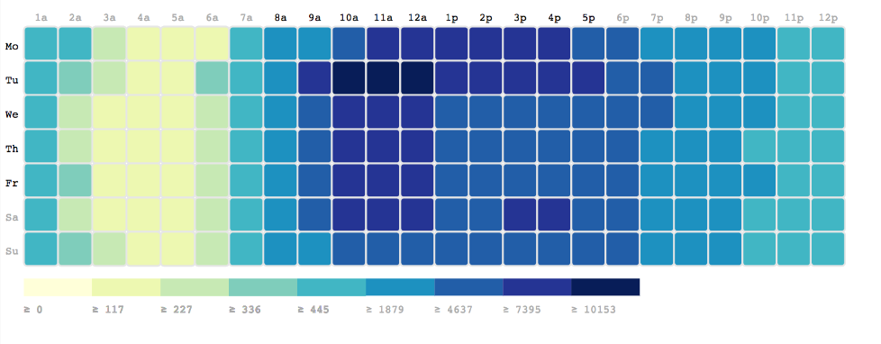
When Matters (Slightly)
One vs others
Notes:
Target product recommendations 11-5PM Mon & Tues to encourage cart additions
Target reorder messaging on Sunday mornings to capture Whale and Guppy activity
Target home essentials/produce recommendations Tues morning for Snap Decision Makers/Ad Hoc Purchasers

Slide 14
Summary
Difficult to predict future behaviors across the board
The most loyal of customers are easier to predict because of patterned behaviors
Most people purchase items on Monday and Tuesdays during work hours – messaging should heavy up during those periods

Slide 15

Checking Out
Email: leang.chaing@gmail.com
Github: https://github.com/leangdamang/

